Slide 1



Garbage Classification Using EfficientNetV2 Model
Submitted by Sarvesh P

Slide 2

Learning Objectives
Understand Image Classification fundamentals
Gain knowledge of Transfer Learning using EfficientNet
Learn Data Augmentation for robust model training
Evaluate model with accuracy and confusion matrix
Deploy model with Gradio for real-time image prediction
GOAL
Source :
www.freepik.com/

Slide 3
Tools and Technology used
Category | Tools/Technologies
Programming | Python
Deep Learning | TensorFlow, Keras
Data Visualization | Matplotlib, Seaborn
Model Evaluation | scikit-learn (confusion matrix, reports)
Pretrained Model | EfficientNetV2B2
Interface Deployment | Gradio
Development Platform | Google Colab (Cloud GPU)

Slide 4
Methodology
Data Collection and Augmentation
Model Building with EfficientNetV2B2
Training with class imbalance handling
Optimization with Callbacks
Evaluation using metrics and confusion matrix
Deployment through Gradio interface

Slide 5
Problem Statement:
To develop an accurate and efficient garbage classification model using EfficientNetV2B2 and transfer learning for automated waste sorting..

Slide 6
Solution:
We developed an AI-based Image Classification system using EfficientNetV2B2 to automatically categorize waste images into different trash types.
The solution uses a deep learning model trained on a custom Trash Type Image Dataset with advanced techniques like data augmentation, class balancing, and transfer learning to achieve improved accuracy. A user-friendly Gradio web interface allows real-time image classification for practical deployment.

Slide 7
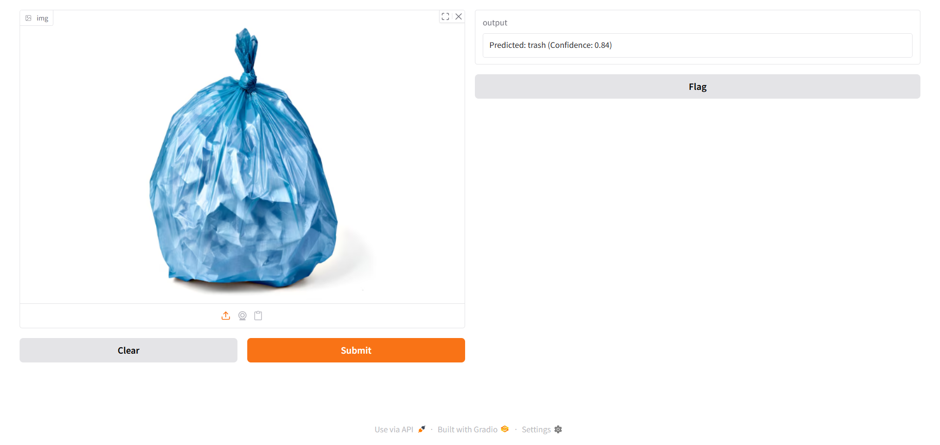
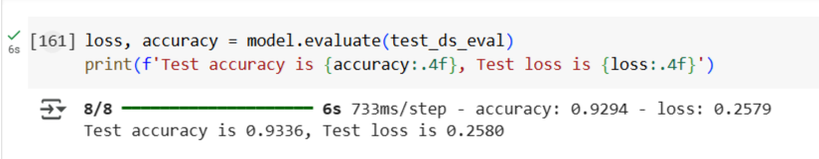
Screenshot of Output:

Slide 8
Conclusion:
The developed trash classification system successfully demonstrates the potential of deep learning and transfer learning in automating waste management. By leveraging EfficientNetV2B2 and Gradio, we achieved high model accuracy and a simple, interactive interface. This solution lays the foundation for real-time, AI-powered waste segregation, contributing towards smarter and more sustainable waste handling in the future.

